Slide 1

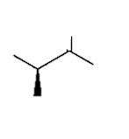
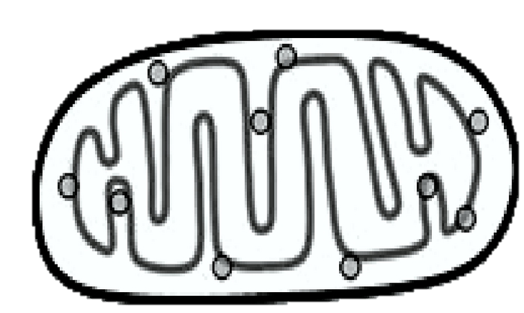
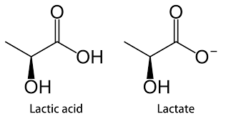
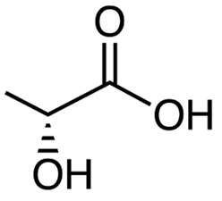


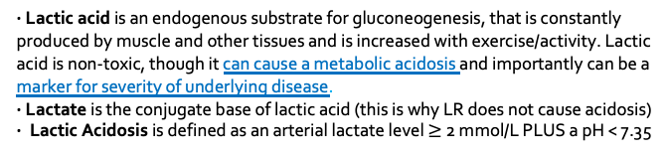

LACTIC ACIDOSIS
by Mark Ramzy DO & Nick Mark MD
onepagericu.com
@MRamzyDO
@Nickmmark
Link to the most current version →
ONE
DEFINITIONS:
Muscles / Other Tissues
· Lactic acid is an endogenous substrate for gluconeogenesis, that is constantly produced by muscle and other tissues and is increased with exercise/activity. Lactic acid is non-toxic, though it can cause a metabolic acidosis and importantly can be a marker for severity of underlying disease.
· Lactate is the conjugate base of lactic acid (this is why LR does not cause acidosis)
· Lactic Acidosis is defined as an arterial lactate level $≥$ 2 mmol/L PLUS a pH < 7.35
Liver
Glucose
Glucose
H₂O
GAPDH
+2 ATP
O
CC BY-SA 3.0
v1.0 (2020-01-25)
Lactate Dehydrogenase
(LDH)
HO
Pyruvate
O₂
ROLE IN DISEASE:
HO
Lactatic acid may be elevated in critical illness due to impaired O2 delivery (Type A lactic acidosis) or impaired O2 utilization by cells (Type B Lactic Acidosis). Rarely, an enantiomer of lactate (D-lactate) may be produced by gut bacteria in patients with bacterial overgrowth, causing another type of lactic acidosis.
Elevation in serum lactic acid is associated with severe sepsis, but lactic acid clearance is unreliable as a resuscitation endpoint.
Pyruvate
Lactate
LDH
Occurs when O₂ is ABSENT
LACTATE
CLEARANCE
· In sepsis & septic shock, lactate elevations may be due to increased $β$² adrenergic tone rather than end-organ hypoperfusion
· Septic patients with elevated lactate typically have hyperdynamic circulation & O2 delivery
Importantly, in severe sepsis increasing oxygen delivery (DO2) may not increase O2 consumption (VO2) nor does it affect lactate clearance.
Oxidative Phosphorylation
70% Liver
20% Kidney
10% Muscle
Anaerobic
(DO₂ < VO₂)
Type-A
lactic acidosis
Aerobic State
(VO₂ < DO₂)
Type B
lactic acidosis
O₂
H₂O
The Cori Cycle: Oxygen deprived cells produce lactate. In the presence of O2, the liver/kidney convert lactate back to pyruvate, repaying the “oxygen debt” of the tissue
Liver and Renal dysfunction will increase lactate due to impaired clearance
VO₂
+
H⁺
^{Hydrogen Ion}
delivery of oxygen (DO₂) is dependent on the following:
cardiac output (CO) & blood O₂ content (CaO₂)
L-Lactate
DO₂
$$DO_{2}= \left(HR × SV\right) × \left[\left(1.34 × Hb × SaO_{2}\right)+(PaO_{2 }× 0.003)\right]$$
TYPE A: IMPAIRED O₂ DELIVERY (DO₂)
TYPE B: IMPAIRED O₂ UTILIZATION (VO₂)
TYPE D: BACTERIAL OVERGROWTH
D-Lactic Acid
DECREASED O2 DELIVERY
INCREASED O2 DEMAND
DRUGS / TOXINS
IMPAIRED CLEARANCE
- Presents as AG acidosis with negative lactate. Difficult to diagnosis as it requires separate D-lactate testing
- Seen in Short Bowel Syndrome, where decreased carbohydrate digestion leads to presence of additional sugars in the colon.
- Bacteria ferment and convert these sugars into D-Lactate
- Diabetic Ketoacidosis and Propylene Glycol administration have also been associated with D-Lactate accumulation
Consider etiologies that impair adequate perfusion
Hypotension & Hypovolemia
Trauma & burns
Cardiogenic & Septic Shock
Severe Anemia
Cardiac Arrest
Severe Hypoxemia
Regional Ischemia
Compartment Syndrome
Consider etiologies that increase O2 consumption
Stress / Pain / Exercise
Fever
Hypothermia & Shivering
Seizures
$β$eta-Agonists
$↑$ work of breathing
Localized soft-tissue infection
Mesenteric Ischemia
Microcirculatory dysfunction
- Propofol (PRIS),
- Valproic Acid)
- Biguanides (Metformin)
- Linezolid, Lactulose
- HIV Antiretrovirals (esp. NRTIs)
- Acetaminophen
- Ethanol, Methanol & Other toxic alcohols
- Sodium Nitroprusside
- Others (ie. Ricin, Strychnine, Niacin, Salicylates, Isoniazid)
- Systemic liver Failure
- Renal failure
- Mitochondrial dynsfxn
- Inborn Errors of Metabolism
OTHER
- Infections (ie. HIV, Malaria, Late Sepsis)
- Malignancy (Leukemia/Lymphoma)
- Diabetes Mellitus +/- DKA
- Alcoholic lactic acidosis
- Deficiencies (Thiamine & Biotin)

