Slide 1

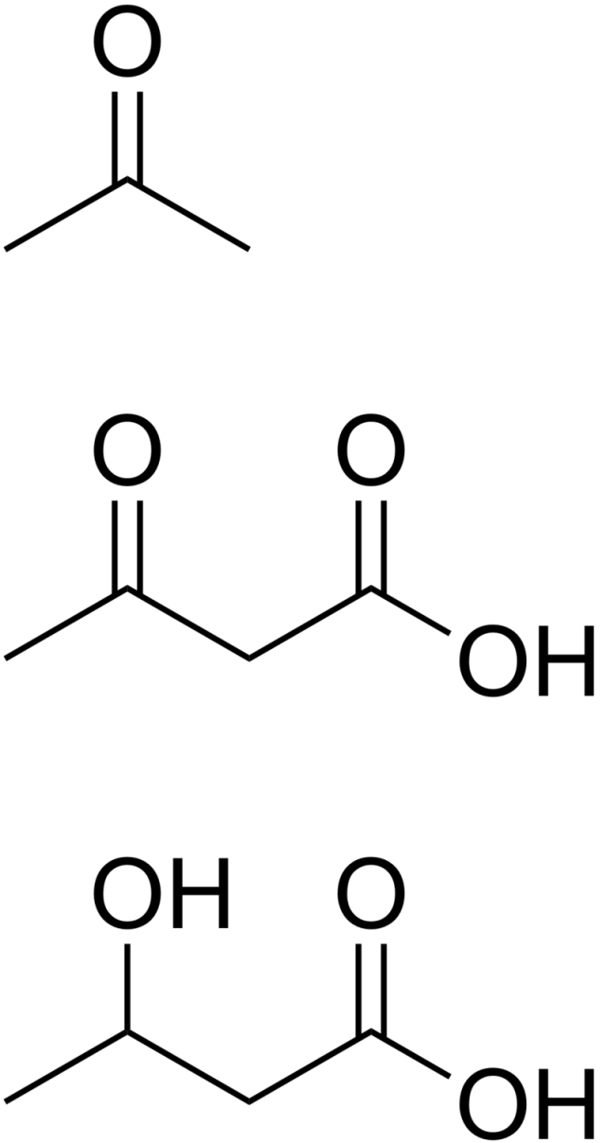
ketosis disorders
onepagericu.com
@nickmmark
Link to the most current version →
by Nick Mark MD
ONE
ETIOLOGY OF KETOSIS
Ketone bodies are a normal metabolic energy source. Excessive unregulated production of ketones, often accompanied by an anion gap acidosis, is seen in several disease states:
 | Starvation Ketosis | AKA | Euglycemic DKA | DKA | DKA/HHS Overlap | HHS
Etiology | Physiologic switch to FA metabolism. | Seen in chronic alcoholics | Seen w/ SGLT2 inhibitors, pregnancy | DM1 (or ketosis prone DM2) Young > elderly | DM1/2 Highest mortality | DM2 Elderly > young
BG (mg/dL) | <250 | <250 | <250 | 400-800 | 800-1000 | >800-1200
Ketones | ++++ | ++ | +++ | +++ | + | -
Acidosis | - | ++ | +++ | +++ | ++ | +
Fluid deficit (L) | - | - | 2-4 L | 6-8 L | 6-10 L | 8-10 L
· Starvation ketosis – normal consequence of fatty acid (FA) metabolism. Tx: provide carbohydrates (IVF or PO): The pt will produce endogenous insulin normally. Treat other deficiencies (thiamine). Monitor for development of re-feeding syndrome.
· Alcoholic ketoacidosis (AKA) – seen in chronic alcoholics, often can be treated with dextrose containing IVF & thiamine. Treat concomitant alcohol withdrawal.
· Diabetic ketoacidosis (DKA) – caused by complete insulin deficiency, leading to marked anion gap acidosis (pH < 7.35) w/ elevated blood glucose. Euglycemic DKA is
a variant seen with SGLT inhibitors & pregnancy, where blood glucose (BG) is normal.
· Hyperglycemic hyperosmolar state (HHS) – partial insulin deficiency, causing minimal ketosis but marked increase in BG & osmolality. Glucosuria causes massive volume loss.
· DKA/HHS Overlap – features of both DKA & HHS and treated the same.
CAUSES/WORKUP OF DKA/HHS
INSULIN bolus & gtt
When BG normal, add
glucose to IVF
When AG closed give SQ INSULIN
Identifying the cause of DKA/HHS is essential, because missing the underlying etiology is responsible for much of the morbidity/mortality. Consider the 5 I’s:
WHICH KETONE TO CHECK?
Etiology | Workup
Infection | BCx, Ucx, Procalcitonin, CXR, exam, POCUS
Ischemia | Lactate, Troponin, EKG
Inflammation | Lipase, CRP
Intoxication | Serum Osmolarity (Osm), Blood EtOH, Utox
Insulin (deficiency) | History (e.g. ran out of insulin, oral meds) Consider new meds (e.g. steroids, diuretics, etc)
Checking BHB is more accurate (fewer false positives & false negatives)
Nitroprusside urine test is unreliable.
Fatty acid (FA)
breakdown
IVF boluses for hypovolemic shock
BG, AG, & Fluid Deficit
β-hydroxybutyrate
Acetoacetate
Acetone
NORMAL RANGE
Gradual correction of remaining fluid deficit
Blood test
(most accurate)
Urine test
(semi-quantitative)
Breath test or “sweat” breath odor
INITIAL
INTERMEDIATE
RESOLUTION
Phase
INITIAL PHASE
INTERMEDIATE PHASE
RESOLUTION PHASE
Resuscitation & stabilization
Gradual correction
Normalization & de-escalation
TREATMENT OF KETOSIS:
INSULIN
Bolus INSULIN 10 units IV then
Start INSULIN gtt 0.1 units/kg/hr
Adjust INSULIN gtt to achieve 50 mg/dL/hr reduction in BG
Once AG closed, give SQ INSULIN. 0.1 units/kg. Stop INSULIN gtt 2 hrs later
The three pillars of treating DKA/HHS are INSULIN (to stop ketogenesis), IVF (to restore fluid deficit & correct hyperosmolarity), & ELECTROLYTES (to correct numerous derangements & prevent arrythmia)
HHS requires more FLUID and less INSULIN than DKA (because of greater fluid deficit and less acidosis)
Mild DKA can be treated with SQ INSULIN in the ED or medical wards (does not require ICU admission)
Expected AG is 2.5x albumin (usually <12 mOsm/L); with treatment AG should normalize to expected AG. If not improving consider concomitant lactic acidosis or other metabolic derangement.
Corrected Sodium accounts for spurious low Na+ measurements when blood glucose is high. For every 100 mg/dL increase in BG, the corrected Na is increased by 2.4 mEq/L.
GOAL: correct BG, AG, & acidosis
Monitor BG, Chem10
(Don’t add K to IVF as it slows rate of infusion)
ELECTROLYTES
Replete K⁺ to >4 mEq/L
(ideally both PO and IV)
Use caution if K⁺ < 3.3 mmol/L; consider decreasing insulin gtt
Resume diet; Start basal, prandial, & correction INSULIN. Stop IVF. Begin oral ELECTROLYTE replacement.
GOAL: normalize K⁺, Mg²⁺, Ca²⁺, PO₄, and HCO₃ to avoid arrythmias
Monitor Chem10, ± VBG, EKG
If HCO₃ < 6.9 give NaHCO₃ bolus ± gtt
Correct Mg deficits to reduce further K wasting
(Acidosis greatly increases the risk of cardiac arrest during intubation; consider NIPPV)
IV FLUID
Replace fluid deficits with isotonic IVF ~200 ml/hr
Once tolerating PO
GOAL: restore circulating volume, correct fluid deficit & hyperosmolarity, avoid cerebral edema by correcting the corrected sodium gradually.
calculate corrected Na & Fluid Deficit
Monitor Osm, serum Na, urine output
If in hypovolemic shock, correct rapidly w/ IVF boluses
(e.g. 1 L of LR or 0.9% NS)
v1.2 (2022-07-24) CC BY-SA 3.0
Once corrected Na is >140 mEq/L switch to hypotonic IVF to avoid overcorrection
(e.g. 0.45% NS, LR)
When BG < 200 mg/dL switch to glucose containing IVF
(e.g. D5LR or D5 ½NS)
(Use volume responsiveness to guide resuscitation; Consider balanced crystalloids. E.g Plasmalyte 148)

