Slide 1
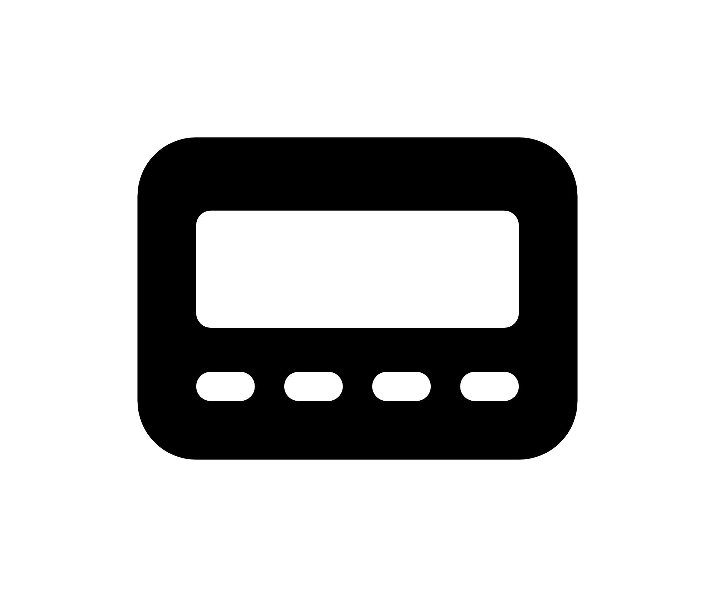
neuromuscular blockade monitoring
&
by Nick Mark MD
onepagericu.com
@nickmmark
Link to the most current version →
ONE
RATIONALE:
Neuromuscular blockade can be a useful adjunct in caring for patients with severe ARDS and may reduce mortality (or not)
There are several mechanisms by which NMB can benefit patients with severe ARDS:
  Improved ventilator synchrony / prevention of patient induced lung injury (e.g. doublestacking)
  Decreased oxygen consumption (respiratory muscles use <2% of VO2 at rest but 10-20% in extremis)
However, NMB can also be harmful:
  Prolonged/excessive NMB is associated with neuromuscular weakness/muscle loss (ICU-AW)
  Prolonged/deeper sedation is associated with increased risk of delirium, neurocognitive impairment
  NMB is associated with increased risk of pressure injuries, corneal abrasions, & DVTs
Thus, NMB should only be administered in patients likely to benefit & only for the shortest time required.
CHOICE OF NEUROMUSCULAR BLOCKER (NMB)
All NMBs are non-depolarizing and administered by continuous infusion.
Cisatrocurium – Metabolized by esterases/spontaneously in plasma (Hoffman elimination); not renally or hepatically cleared. More expensive.
Rocuronium – Mostly hepatic metabolism, though with renal/biliary excretion of metabolites. Avoid in renal failure.
Vecuronium – 40% renal, 60% biliary clearance. Avoid in liver/renal failure.
Call them “NMBs,” “paralytics” sounds scary to patients/families
Severe hypoxemia? (P/F < 120)
Significant dysynchrony?
Increase sedation/analgesia
(typical goal RASS -5)
Titrate neuromuscular blocker
(goal vent synchrony)
Attempt to stop NMB daily; reassess if still indicated
STOP
CC BY-SA 3.0 v1.0 (2021-11-02)
(NMB is NOT required for prone positioning)
(many patients will only require NMB for 24 hrs)
Use EEG/BIS monitor to ensure sedation depth is adequate
Use TOF monitor to ensure NMB is at lowest dose possible
(NMB does not affect smooth muscles, however gut motility may be decreased)
EEG/BISPECTRAL INDEX (BIS) MONITORING:
TRAIN OF FOUR (TOF) MONITORING:
The principle is that EEG monitoring provides an quasi-empiric measure of anesthesia depth, which is used to titrate sedation during NMB. Theoretically this prevents both oversedation & undersedation.
Bispectral index is an algorithmic technique to combine multiple EEG parameters, providing a single numeric output:
  80-100 Awake
  60 – 80 Moderate sedation
  40 – 60 Deep sedation/general anesthesia (typical goal during NMB)
  <40 very deep sedation
There is no evidence that BIS monitoring reduces awareness of NMB, nor that it simplifies sedations (one study found similar sedative doses with more frequent dose adjustments using BIS monitoring)
Muscles are are electrically stimulated 4 times in rapid succession & the number of contractions are noted. Used to titrate NMB to the minimum effective dose.
  After achieving adequate sedation, electrodes are applied and the nerve is stimulated using a low current (10-20 mA); the current is increased until 4 vigorous twitches are seen. Further increasing the current should not lead to more forceful contraction (supramaximal stimulation).
  Once the supramaximal stimulation is documented, NMB is initiated
  Titrate NMB according to the number of twitches seen at the prior current: decrease NMB infusion if fewer than goal twitches seen
4/4 twitches (no need to increase NMB infusion if synchronous)
<75% of receptors blocked
EEG leads applied to forehead
Current BIS value
Trendline of BIS values
2D EEG spectragram shows EEG frequency (vertical) vs time (horizontal) with power (color scale)
(+)
(-)
3/4 twitches (typical GOAL level)
~75% of receptors blocked
Set the energy level
wakefulness
Predominantly low frequency energy
TOF electrically stimulates nerve for 0.2 msec every 0.5 sec
PULSE
BATTERY
2/4 twitches (decrease NMB)
~80% of receptors blocked
TOF
TWITCH
40
80hz
TETANUS
100hz
TETANUS
1/4 twitches (decrease NMB)
~90% of receptors blocked
Look for adduction of the thumb with each stimulation
unconsciousness due to propofol or BZD infusion.
0/4 twitches
~100% blocked
twitches
observed
unconsciousness due to ketamine. Ketamine boluses can increase alpha power falsely raising BIS values.
Frequency (Hz)
ECG electrodes are applied 2 cm apart over the ulnar nerve
(facial nerve can also be used)
train of four
electrical stimuli
Time (sec)
Notes:
NEJM monitoring neuromuscular function

